Slide 2
DATA & TECHNOLOGY SOLUTIONS FOR OPPORTUNITY YOUTH
Breakout #2: Opportunity Matching

Slide 3

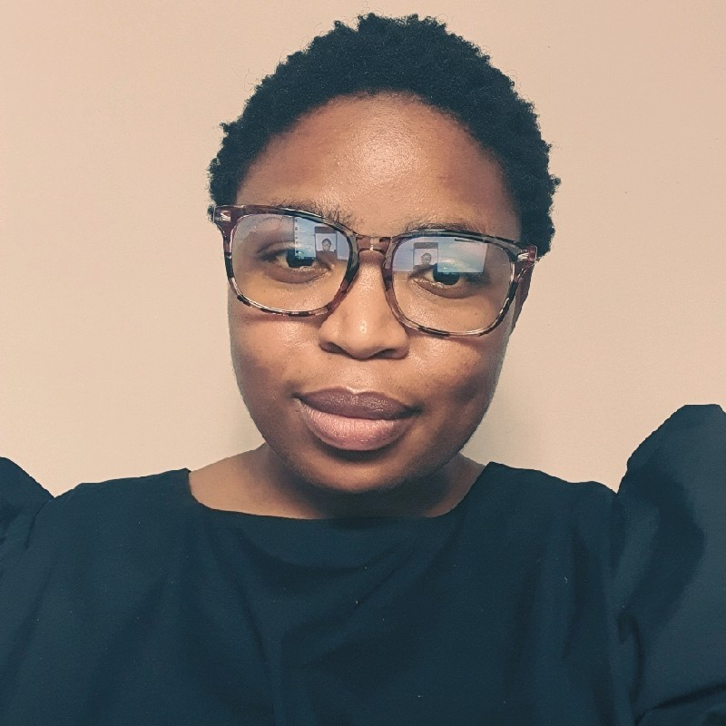
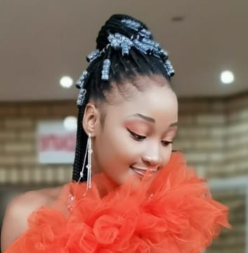
OPPORTUNITY MATCHING
Facilitator
ALICE GUGELEV
Global Development Incubator
NOKUBONGA GUMBI
GOYN eThekwini, Harambee
Rearabetswe Nell
GOYN eThekwini, Harambee

Slide 4
AGENDA
1
GOYN eThekwini / SA Youth case study – 15 min
2
Case study Q&A – 10 min
3
Group discussions – 15 min
4
Feedback from group discussions – 10 min

Slide 5

GOYN GLOBAL CONVENING

Slide 6
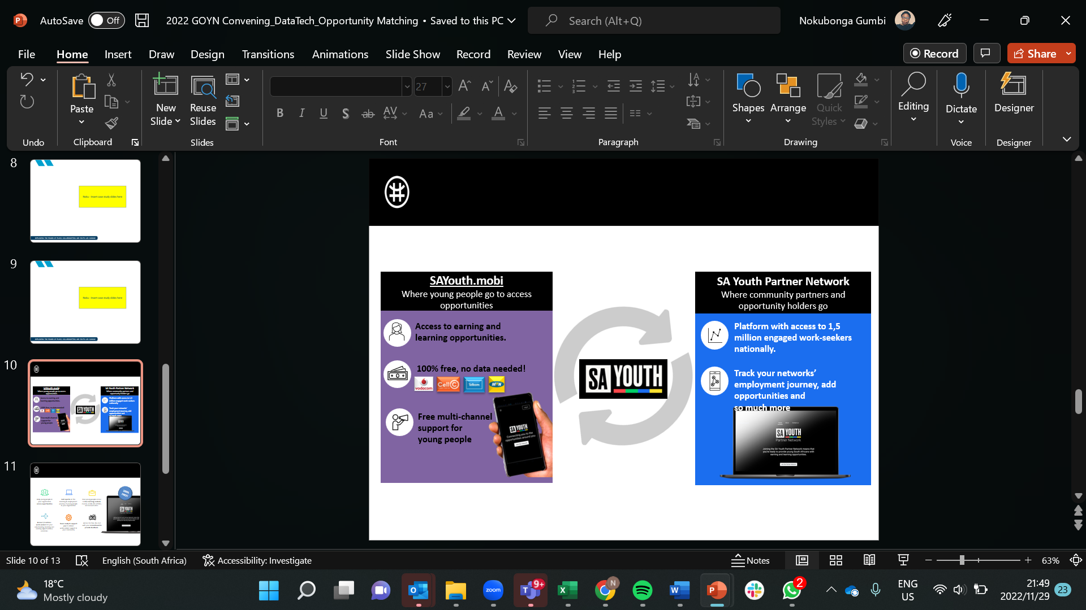

Slide 7
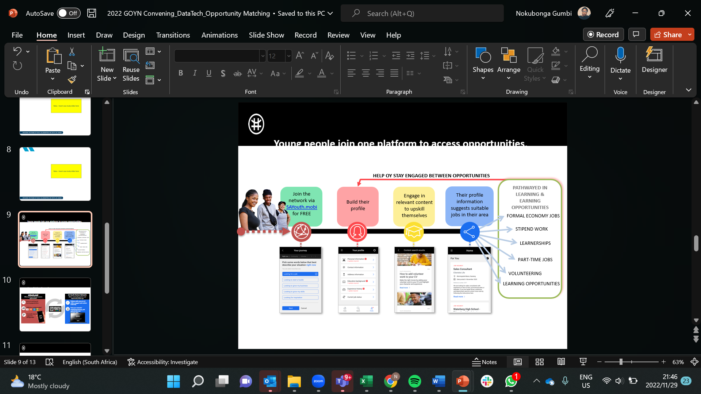

Slide 8
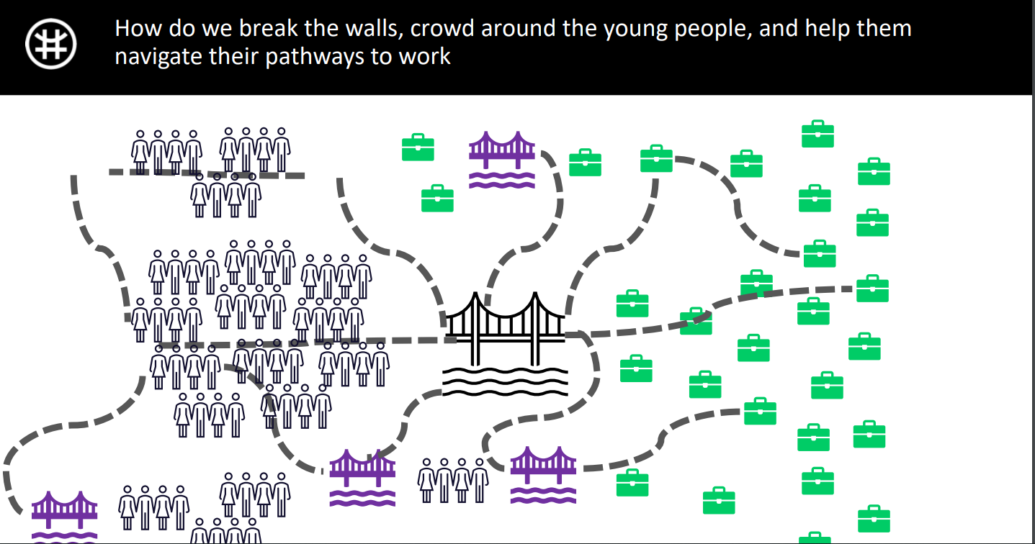

Slide 9
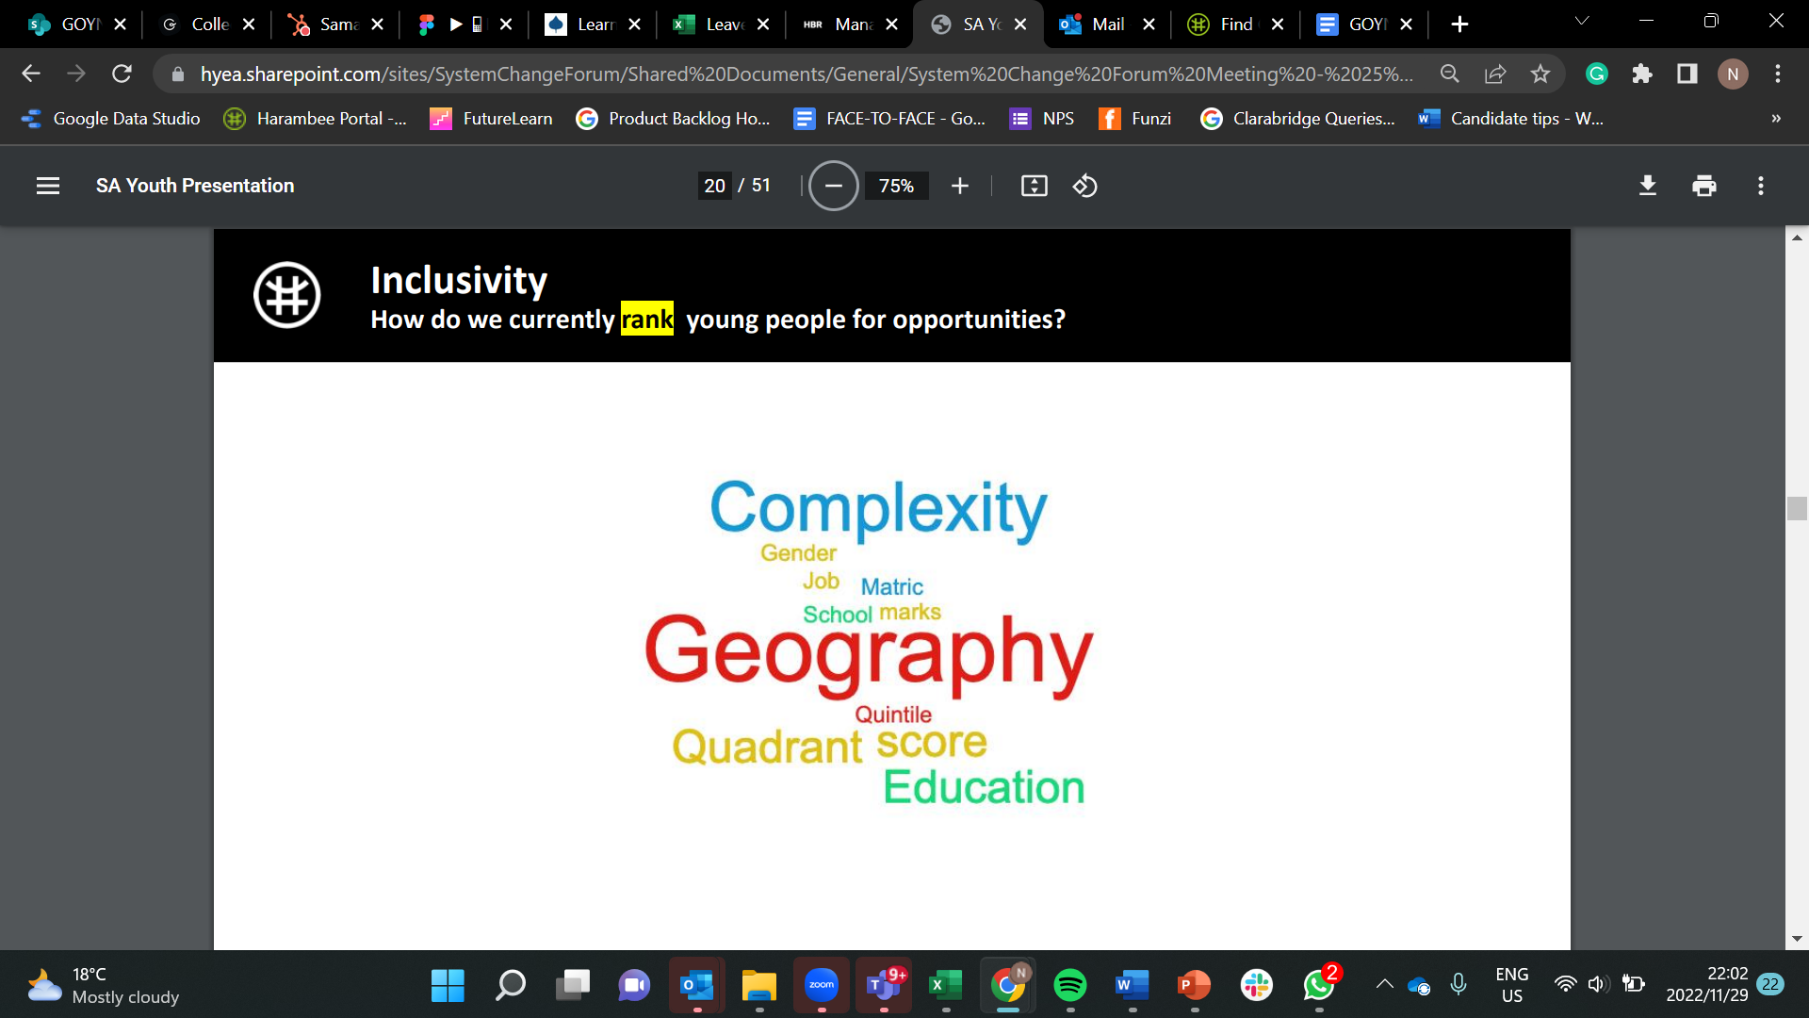

Slide 10
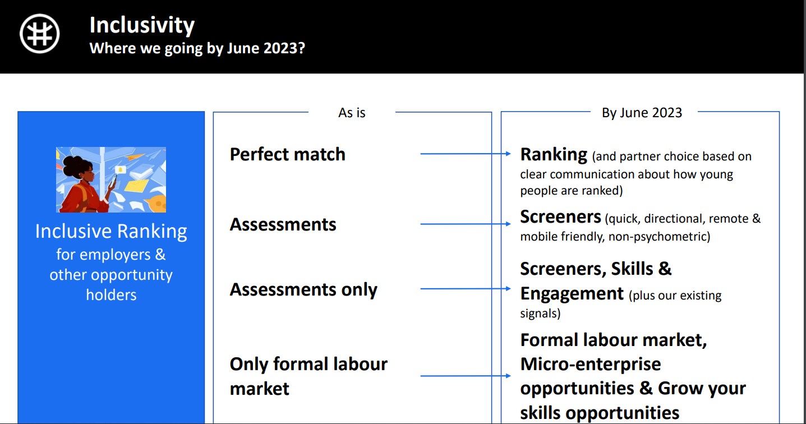

Slide 11
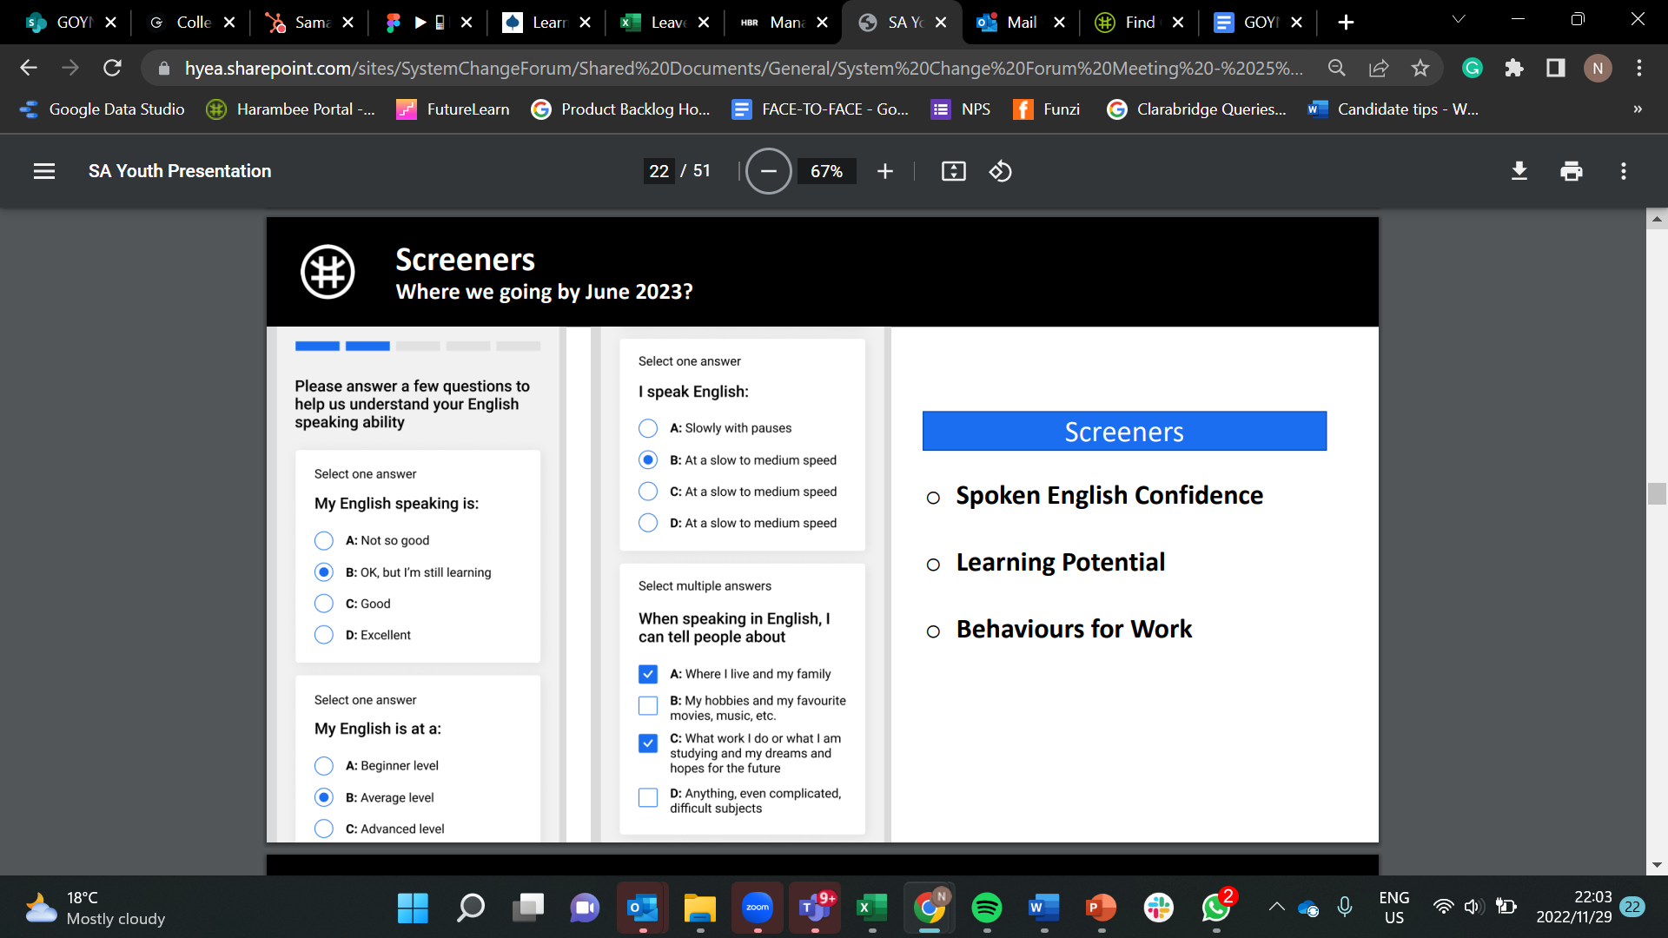

Slide 12
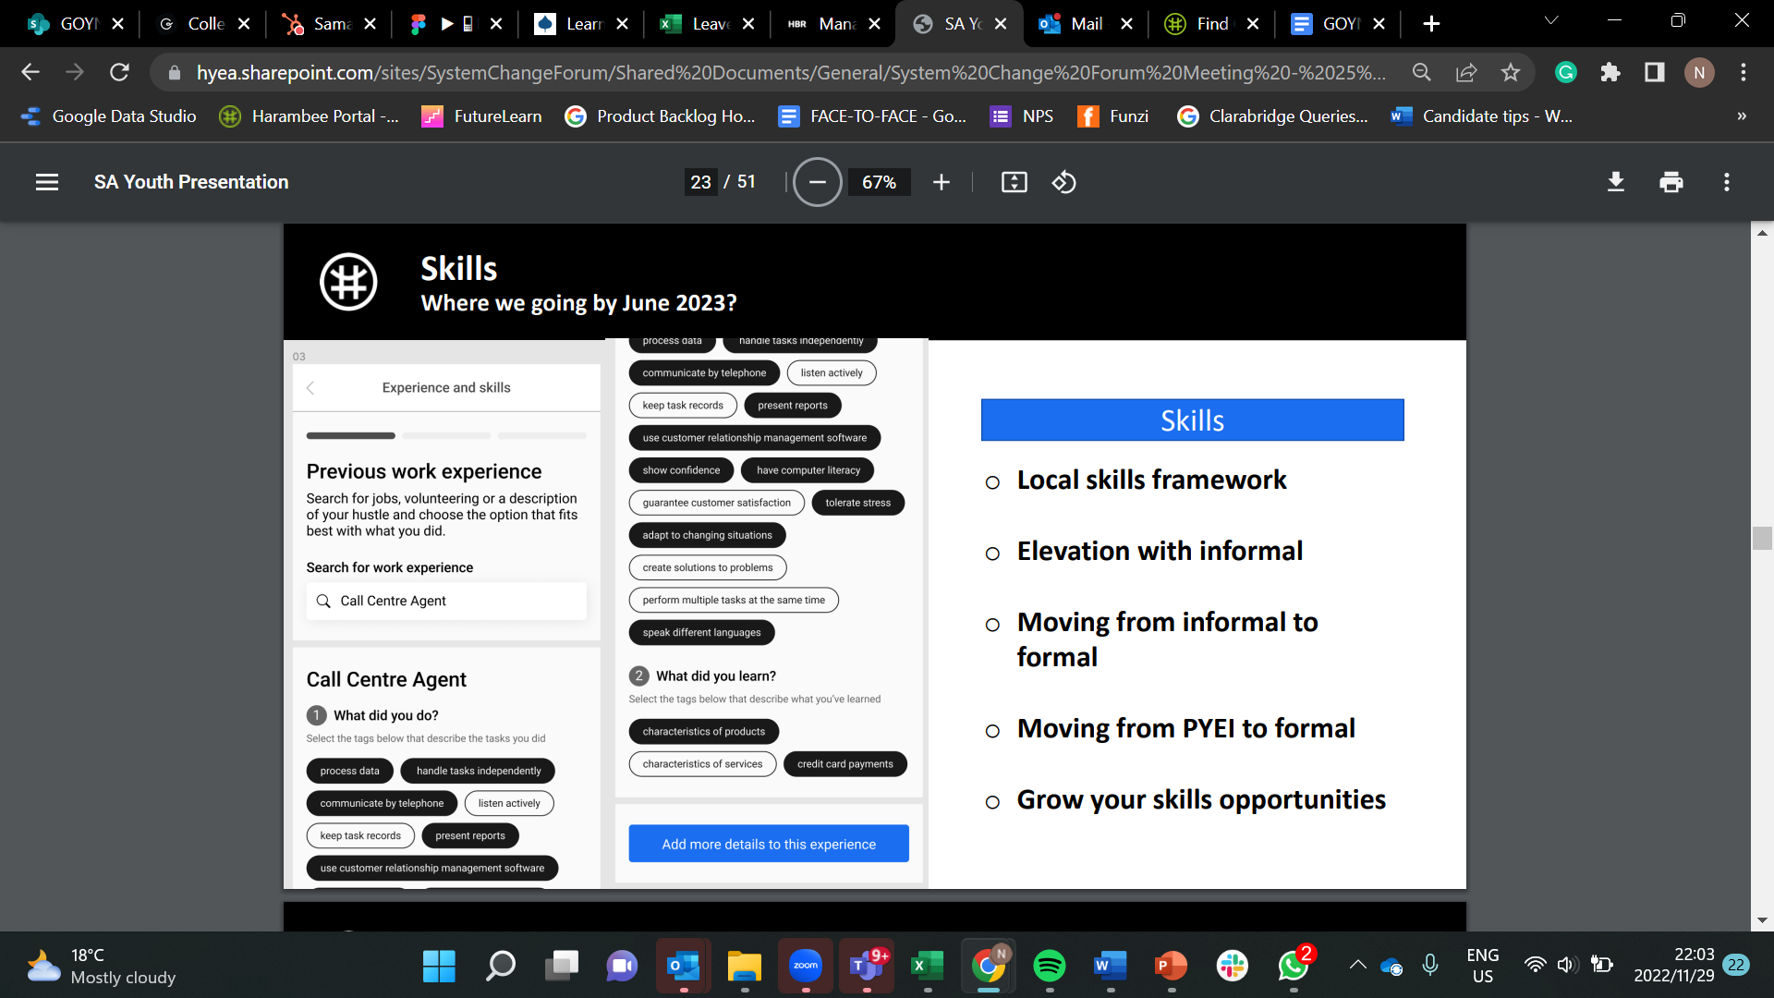

Slide 13
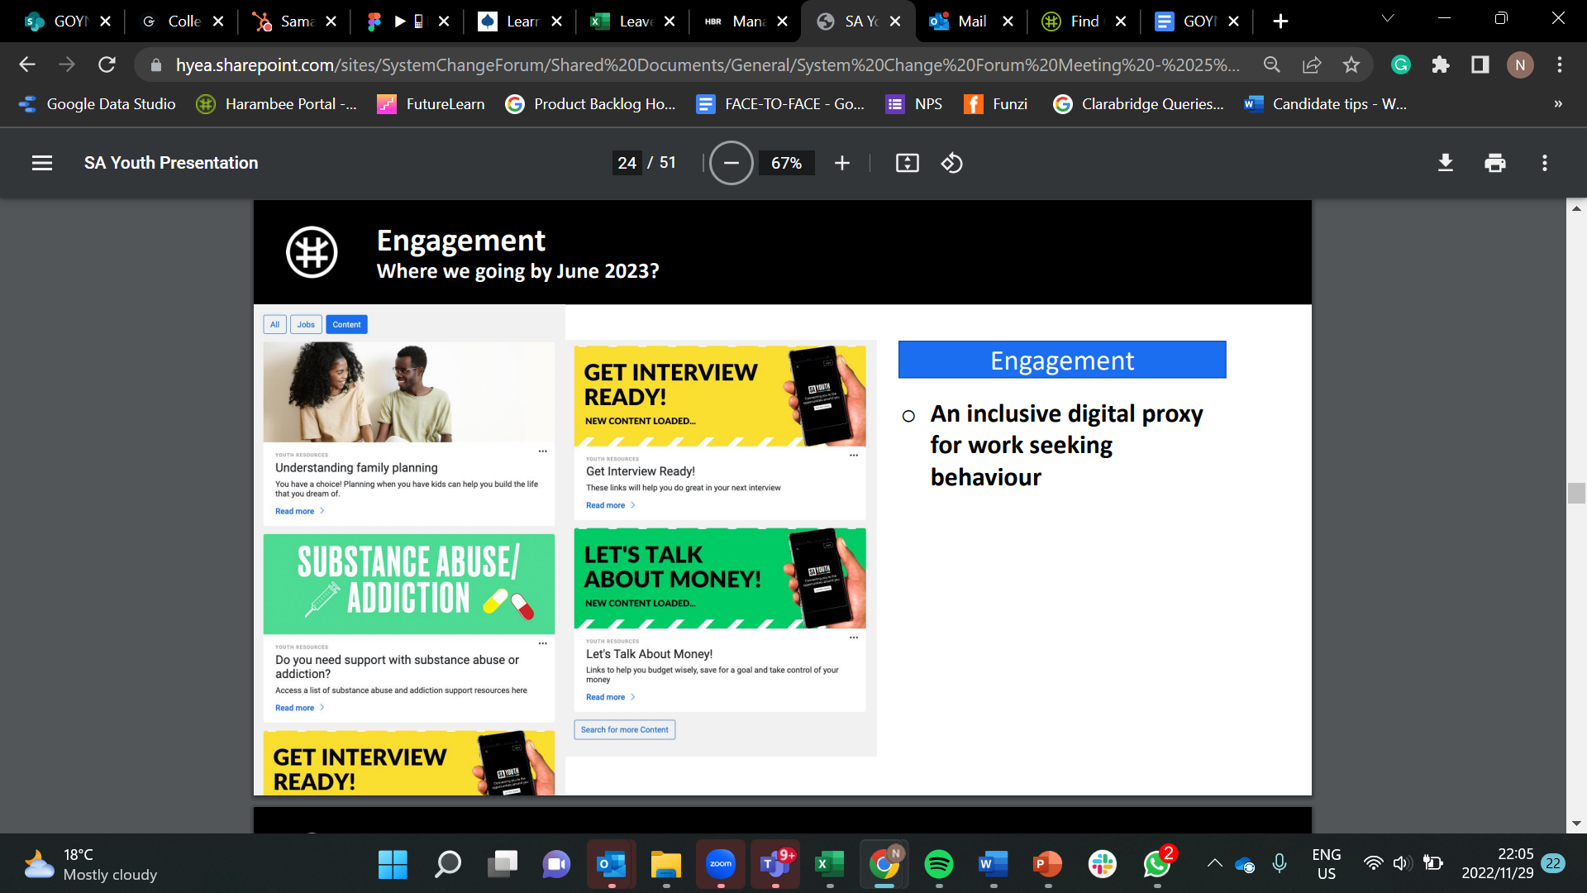

Slide 14
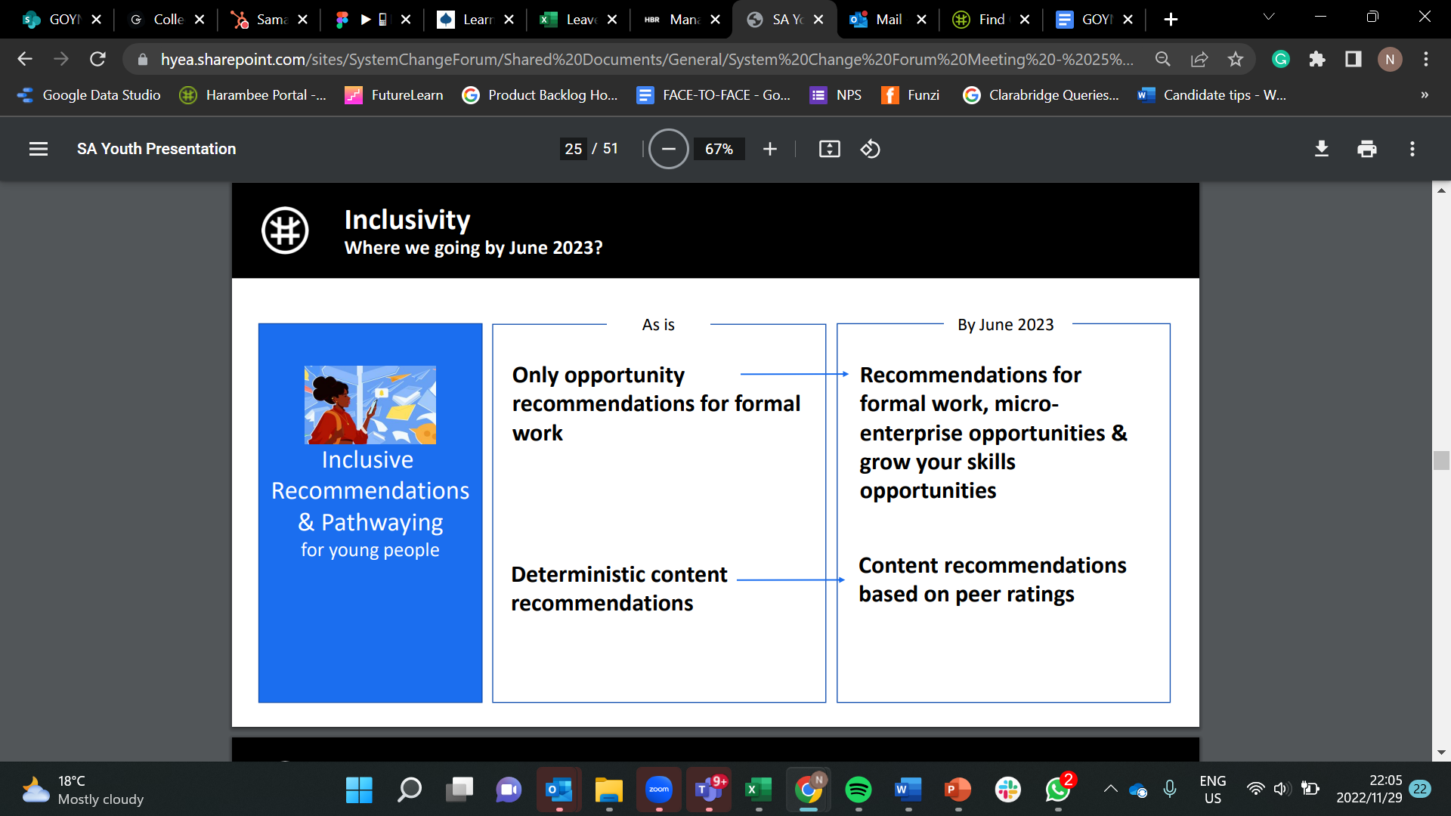

Slide 15
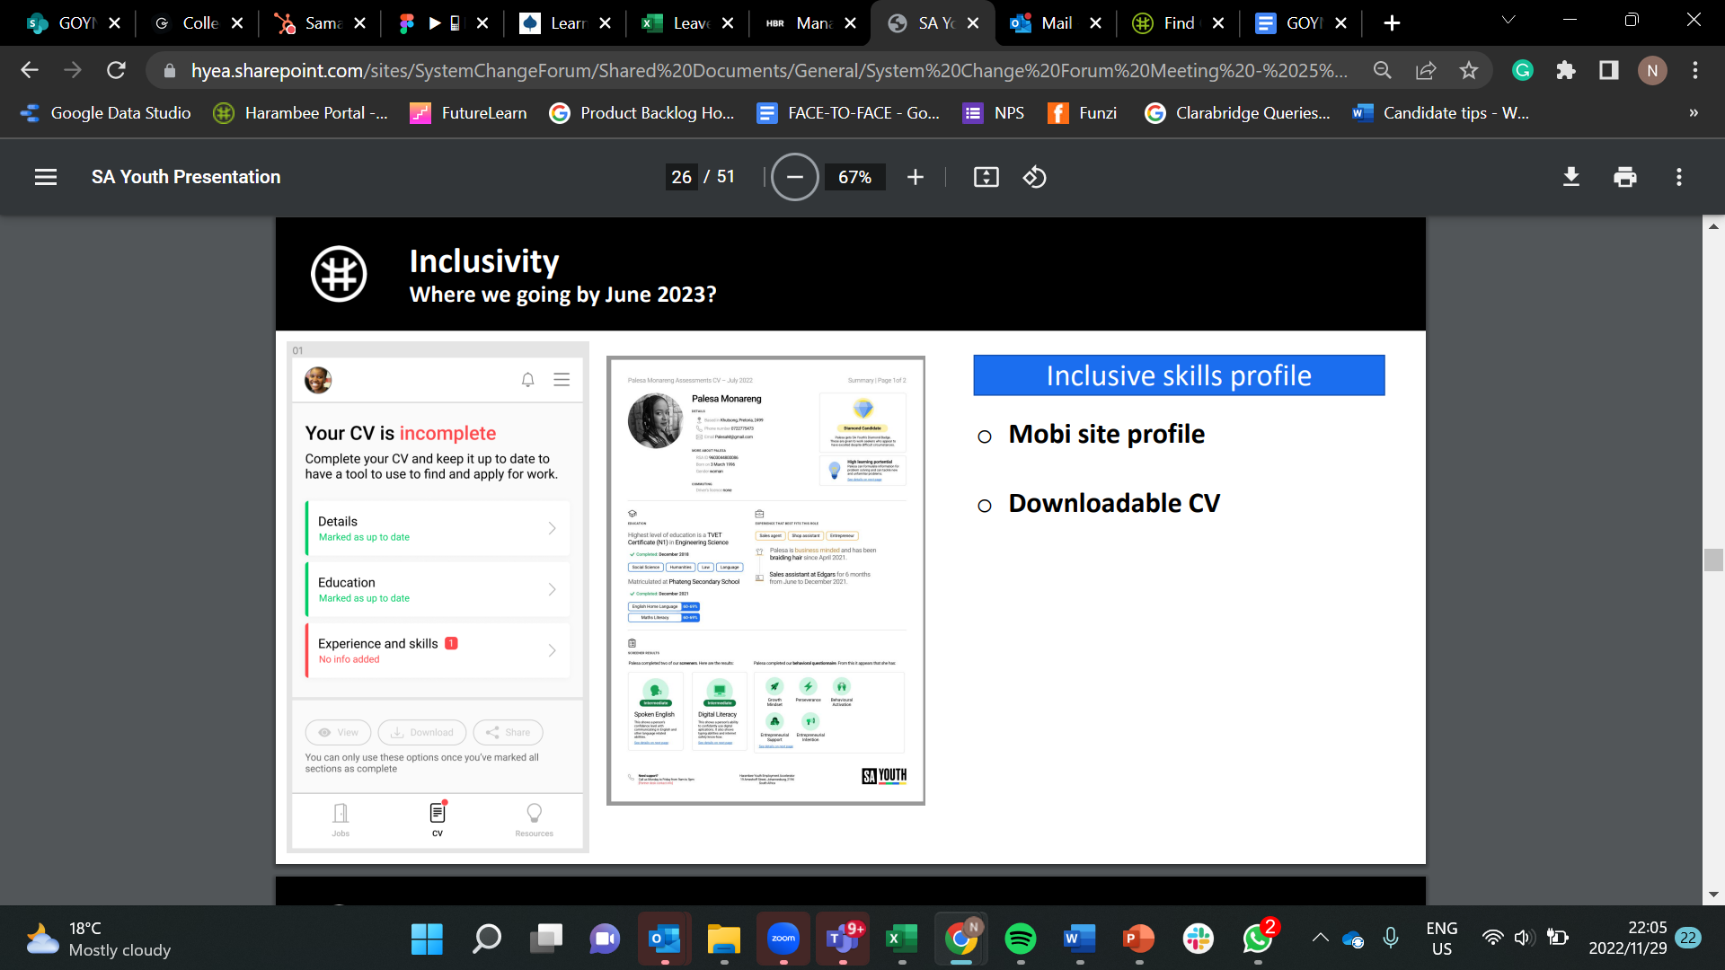

Slide 16
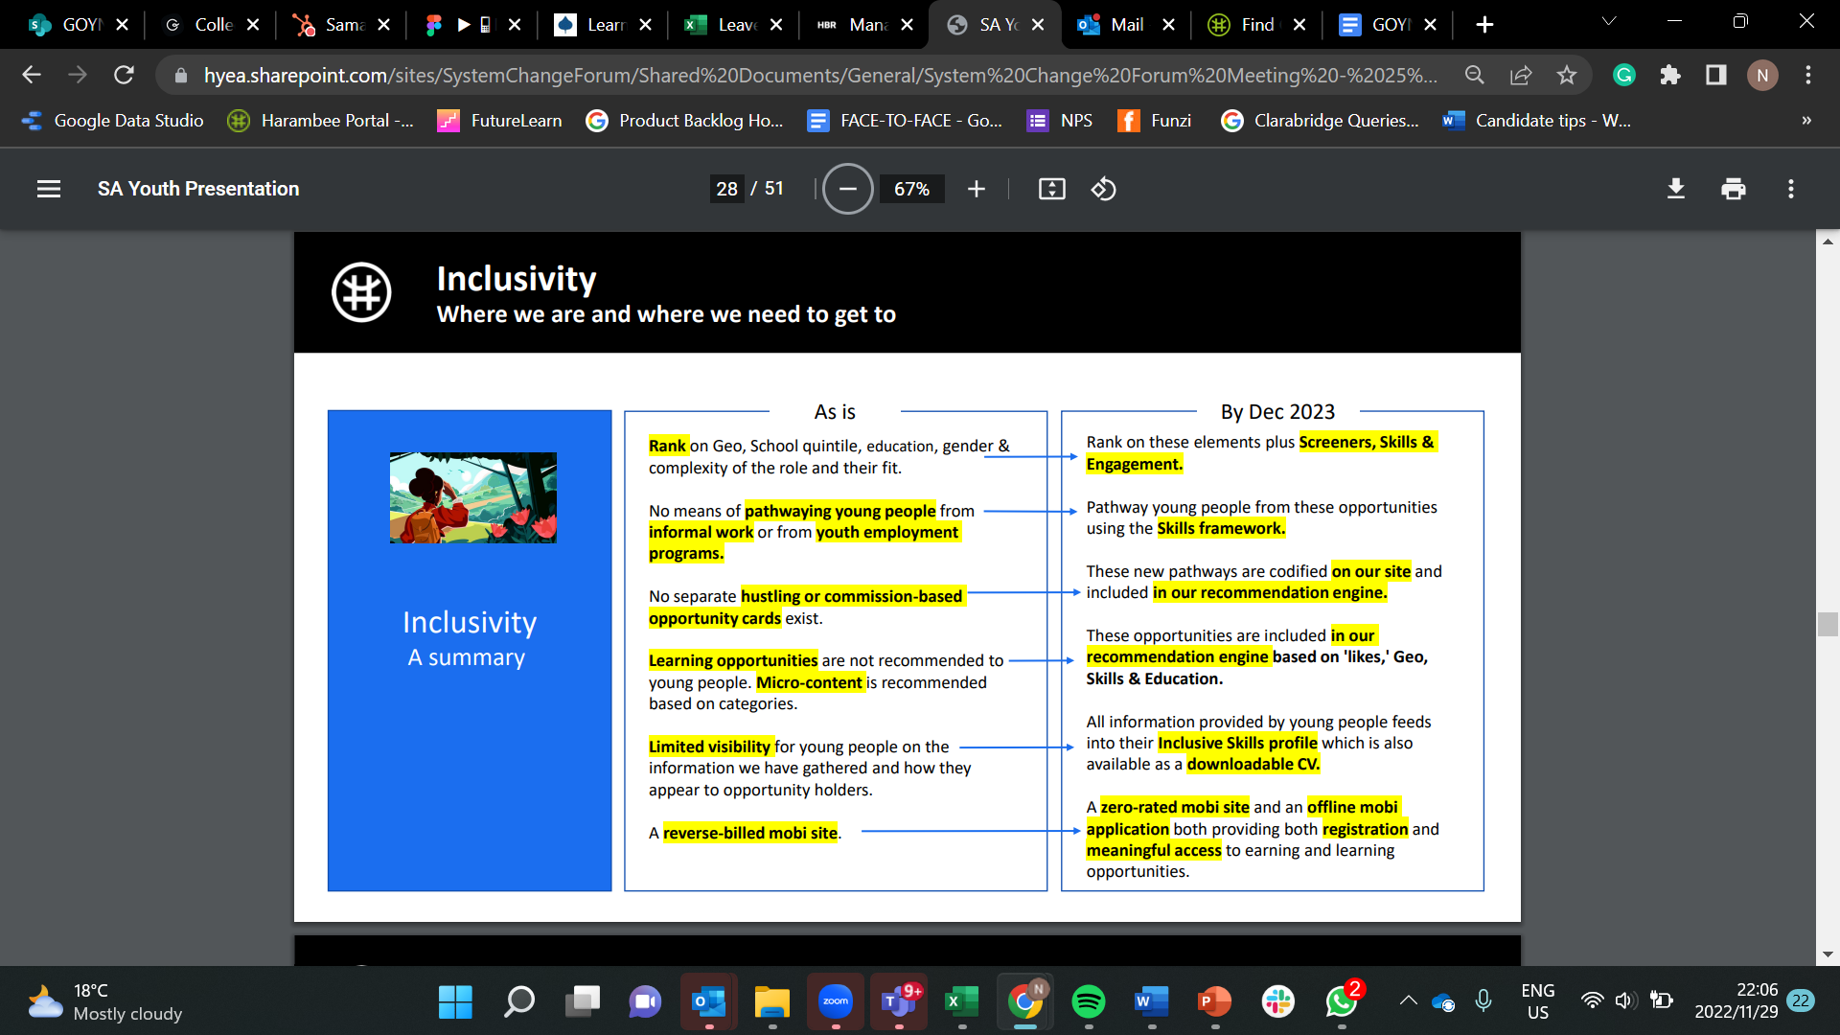

Slide 17
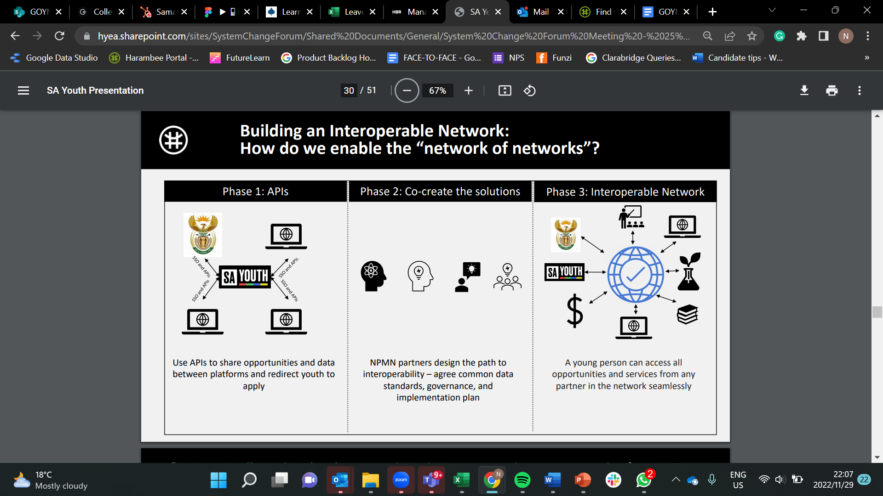

Slide 18
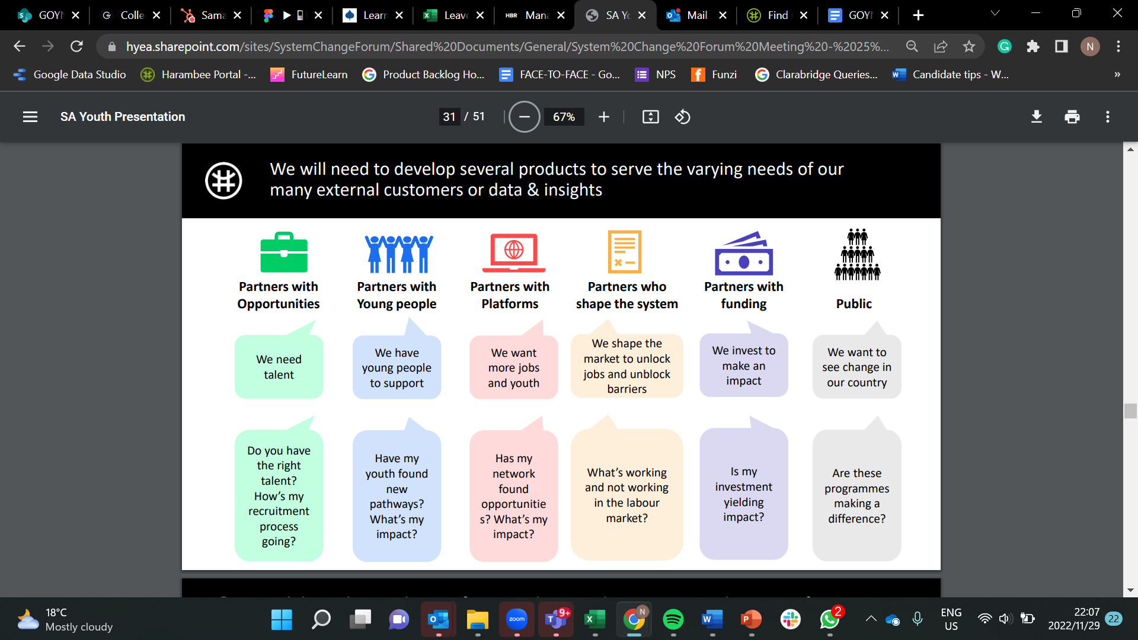

Slide 19
Thank you!
Keen to hear your questions

Slide 20
GROUP DISCUSSIONS
1
What are the characteristics of an effective matching platform?
2
How can matching platforms be used to expand OY’s view of accessible / suitable opportunities?
3
How should equity considerations be built into matching platforms?

