Slide 1
GOYN Data and Tech CoP #2:
Artificial Intelligence in Youth Programming
EMERGING TECHNOLOGIES:
Nyambura Kariuki
29th May 2024

Slide 2
TABLE OF CONTENTS
GLOBAL DATA & TECHNOLOGY COP – ARTIFICIAL INTELLIGENCE IN YOUTH PROGRAMMING
1. AI KEY CONCEPTS Technology over time, AI definition, components, AI in our lives, navigating AI concerns
2. AI AND YOUTH ECONOMIC EMPOWERMENT Impact of AI on demand-sector needs, mitigating concerns, potential use cases, case study
3. GOYN USE OF AI Community implementations and results from the AI survey
4. CONCLUSION Considerations and next steps
5. ANNEX Resources for further learning and exploration

Slide 3






1. AI KEY CONCEPTS
Milestones’ that have shaped the technology landscape
Early Era
Mobiles and Digital Era
Data Exploration
Machine Learning &
Neural Networks
Gutenberg Press (1440): Mass production of printed materials democratized access to information
Steam Engine (1712): Marked the Industrial Revolution, powering production and transportation advancements
Telephone (1876): Revolutionized communication, enabling real-time voice connection across distances
  1947: Transistors, miniaturized electronics, enabling smaller, more portable devices
  1970s brought computing power to individuals
  1973: The first commercially available mobile phone, the Motorola DynaTAC 8000X
2000s: Growth of social media, cloud computing and the emergence of Big Data as a concept, driven by the increase in data volume, velocity, and variety.
Ongoing: Machine Learning, a subset of AI, gained prominence. Neural networks, inspired by the human brain, became the backbone of sophisticated AI algorithms
NLP!!!!: Various implementations of natural language processing
The Technological Revolution
The Rise of Internet
Rise of AI
1943: The first electronic computers (ENIAC). Paved the way for the digital age, ushering in an era of information processing and computing
  1969: The birth of the ARPANET, the fundamental protocols and technologies that allow computers to communicate across networks
  1989: The World Wide Web connected information globally, fostering communication, collaboration, and commerce
  2010s” Advancements in Internet of Things and Artificial Intelligence – the culmination of decades of technological progress in various fields & connecting physical objects to the internet, driving automation, data collection, and smart experiences. Impacting decision-making, automation, and problem-solving.

Slide 4

1. AI KEY CONCEPTS
Artificial intelligence – Aligning on definition
Artificial Intelligence (AI) refers to the simulation of human intelligence in machines that are programmed to think, learn, and perform tasks autonomously
OR
The capability of computer systems or algorithms to imitate intelligent human behavior
Source: Artificial intelligence Definition & Meaning - Merriam-Webster

Slide 5
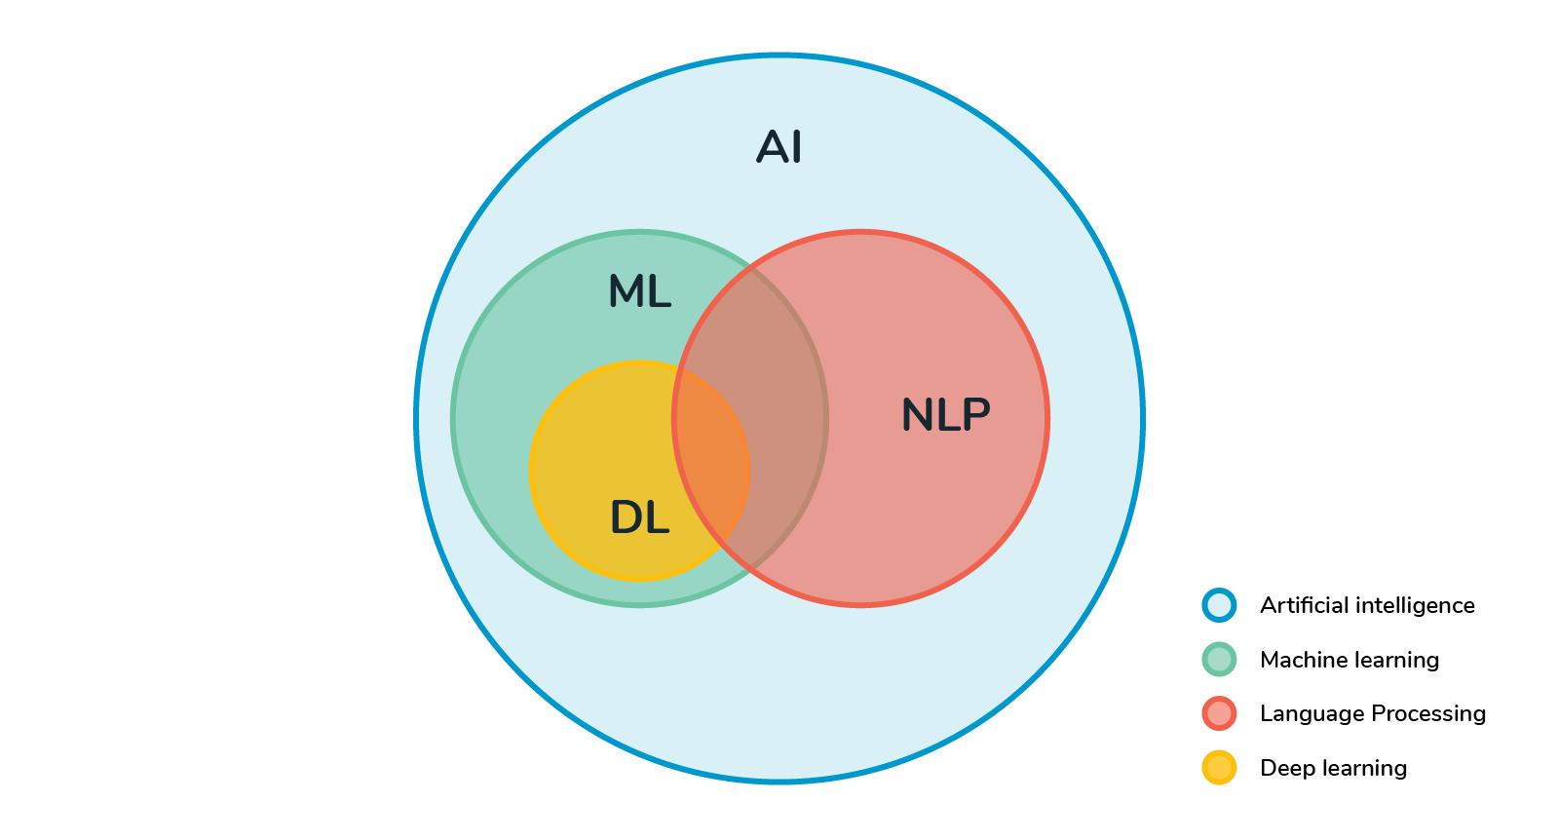
1. AI KEY CONCEPTS
Components of AI
AI is the broader concept of machines simulating human intelligence, covering a wide array of tasks
Machine Learning (ML), a subset that empowers machines to learn from data, recognize patterns, and make decisions without being explicitly programmed. It's like giving machines the ability to learn and improve from experience.
Natural Language Processing (NLP) is another subset, focusing on the interaction between computers and human language. It involves understanding, interpreting, and generating human-like language. Think of it as making communication between machines and humans more seamless.
Deep Learning (DL) takes ML a step further. It's a subfield of ML that involves neural networks with multiple layers (deep neural networks). DL is particularly powerful in handling complex tasks like image and speech recognition, language translation, and more. It adds depth to the learning process.
Source: This Photo by Unknown Author is licensed under CC BY-SA

Slide 6
3 types of AI
1. AI KEY CONCEPTS
Narrow AI
(Weak AI)
Specialized in performing specific tasks, they can automate repetitive workflows, enhance decision-making, and deliver personalized recommendations
e.g. image recognition, natural language processing, predictive analytics or implementations such as Siri, Apple's virtual assistant & Google’s assistant designed for specific tasks like setting reminders, sending messages
2. General AI
(AGI)
Versatile problem solving; capable of understanding, learning, and executing tasks across diverse domains, like human intelligence
General AI is still (somewhat) theoretical, an illustrative example could be an AI system that, like a human, can comprehend, learn, and perform a wide array of tasks across diverse domains. Presently, no fully realized General AI exists
3. Super AI
(endless possibilities)
It is commonly referred to as artificial superintelligence and, like AGI, is strictly theoretical. If ever realized, Super AI would think, reason, learn, make judgements and possess cognitive abilities that surpass those of human beings.
Artificial Superintelligence is currently theoretical, and there are no existing examples. If realized, it would hypothetically possess cognitive abilities surpassing human intelligence, making decisions, learning, and reasoning at a level far beyond human capacity.
Source: Understanding the different types of artificial intelligence - IBM Blog

Slide 7
AI is already seamlessly part of our daily lives
1. AI KEY CONCEPTS
E-commerce and Personalization
AI algorithms analyze past behavior to predict future preferences, making recommendations more accurate
Transportation and Navigation
Autonomous vehicles and AI-driven navigation apps optimize travel routes and enhance safety on the roads
Everyday AI Experiences
We experience AI when our email filter spam, personalized adverts, social media platforms curate content, or our smartphones predict text as we type
AI in Healthcare
Wearable devices and health apps use AI for monitoring and providing valuable insights

Slide 8
TABLE OF CONTENTS
GLOBAL DATA & TECHNOLOGY STRATEGY – ARTIFICIAL INTELLIGENCE
1. AI KEY CONCEPTS Technology over time, AI definition, components, AI in our lives, navigating AI concerns
2. AI AND YOUTH ECONOMIC EMPOWERMENT Impact of AI on demand-sector needs, mitigating concerns, potential use cases, case study
3. GOYN USE OF AI Community implementations and results from the AI survey
4. CONCLUSION Considerations and next steps
5. ANNEX Resources for further learning and exploration

Slide 9


Use cases: AI’s potential to leapfrog youth economic empowerment
2. AI and youth economic empowerment
From personalized learning to program optimization, AI offers a vast array of possibilities for empowering young minds,
“if looked at from an optimistic view, it serves as an assistant to help OY achieve their full potential”…
Personalized and adaptive Learning
AI brings personalized learning paths, adjusting content content and pace to individual learning needs, enabling more effective skills development
Career Exploration
AI-driven tools provide valuable insights into potential career paths, helping young individuals make informed decisions about their future
Creative Expression
AI tools enhance creative expression, allowing youth to explore artistic endeavors
Targeting Resources
From personalized job matching, virtual career coaching, automated mentorship. AI enables targeted support by analyzing data to identify specific needs within youth programs
Data Analysis for Program Optimization
Implementers can leverage AI for data analysis, machine learning to predict skill gaps and future labor demands and NLP can automate the review and scoring of job applications, optimizing program effectiveness, prediction & identifying areas for improvement
Equity & Access
AI-driven language models and bots that help the uneducated, illiterate and persons with disability to use technology and data to access information and opportunities through voice

Slide 10
AI is creating demand for new skills
2. AI and youth economic empowerment
Examples of AI driven demand of skills in the ecosystem
Prompt Engineer: Prompts and interacts with AI software to get the desired outputs
AI Content Writer: Creates content tailored for specific AI applications, like chatbots or virtual assistants
Business Analyst - AI: Analyzes business needs and identifies how AI can be used to improve efficiency and effectiveness
Programming and Coding: Proficiency in programming languages such as Python, Java, or C++ is crucial for building and implementing AI algorithms.
Data Science and Analytics: Analyzes and interprets data to inform AI development and decision-making
AI Security Engineer: Ensures the safety and security of AI systems and data
Machine Learning Expertise: Familiarity with popular machine learning frameworks like TensorFlow or PyTorch is valuable for implementing and deploying machine learning models
Employers are adapting and demanding the ability to actively contribute to projects, research, and applications in the rapidly evolving AI landscape

Slide 11




The AI vs. human debate
2. AI and youth economic empowerment
Crowdsourced insights from gig economy platforms – Impact of AI on jobtech platforms by Jobtech Alliance
At Runnovate, we match entrepreneurs with virtual assistants. When AI gained popularity, fears arose that it would replace virtual assistants in tasks like content writing and data entry. However, the reality is different. Our observation so far is that AI serves as a productivity booster, not a replacement
The real impact of AI on Bridgia has been the drastic reduction of cost and access to “expertise” in order to develop e-learning programs, content and assessments. It has helped us to stay lean in cost and personnel
We see AI poised to bring a certain positive magic to customized upskilling and career pathways, and that’s great. But we also see AI already removing demand for certain digital jobs, like entry-level software engineers and data scientists.
I hope this anecdote doesn’t become the norm… or that AI soon unleashes some new high volume job categories we can’t envision yet!
Many businesses in Sub-Saharan Africa have a can-do attitude that want to make success happen, but have been let down by education or lack of resources.
Our AI-enabled tool, DOER Business, gives small businesses super intelligence in their pocket.
We’re targeting what we believe will be the highest impact case study of Generative AI: a suite of software that can transform each small business into a thriving engine of the local economy – Access to strategic resources for small businesses

Slide 12
AI is causing discomfort and concern on the future of work
2. AI and youth economic empowerment
Some of the common concerns on AI disruption:
Job Displacement: Some fear that AI and automation might lead to job displacement
Privacy Issues: Privacy worries regarding the collection of personal data
Security Risks: Fears of malicious use of AI and safety of children
Social Impact: Worries about AI influencing social dynamics and increasing poverty gap
Social biases: Increase of inequity, injustice and scaled unconscious biases based on training data
Regulatory Challenges: A call for Governments to implement effective regulations & policies
Addressing these concerns is crucial for fostering a balanced understanding of AI's impact and ensuring responsible development and adoption

Slide 13
Individual and collective efforts are needed to mitigate these concerns
2. AI and youth economic empowerment
involves a combination of strategies, ethical considerations, and proactive measures
Bridge the demand/supply gap to ensure training courses align with the dynamic needs – teach our generations on how to learn/continuous upskilling
Basic digital skills to every individual as a basic need
Creation of community forums where citizens/users have a voice in the development and deployment of AI technologies
Transparency of machine training data & feedback loops to mitigate against inequities (Human intelligence remains relevant to monitor AI)
Adopt privacy-centric practices such as anonymizing personal data, implementing strong encryption, and providing clear consent mechanisms for data collection. Privacy by Design
Proactive cyber security measures to ensure the continuous evaluation and improvement of platform security
Collaborate with regulatory bodies to develop industry-specific AI standards that ensure responsible and ethical use

Slide 14
Ethical use and implementation of AI is essential for positive gains in our ecosystems
2. AI and youth economic empowerment
As we harness the power of AI in youth programming and AI Concerns, it's imperative to address ethical considerations, ensuring the well-being, privacy, and fair treatment of Opportunity Youth is our priority
Privacy Concerns: Obtaining informed consent and protecting sensitive information are foundational
Fairness and Bias: Fairness and bias in AI algorithms are critical considerations, transparency in decision-making processes is key to minimizing bias
Inclusivity: All actors should commit to inclusivity, creating AI solutions that cater to diverse needs and backgrounds, ensuring accessibility for all

Slide 15
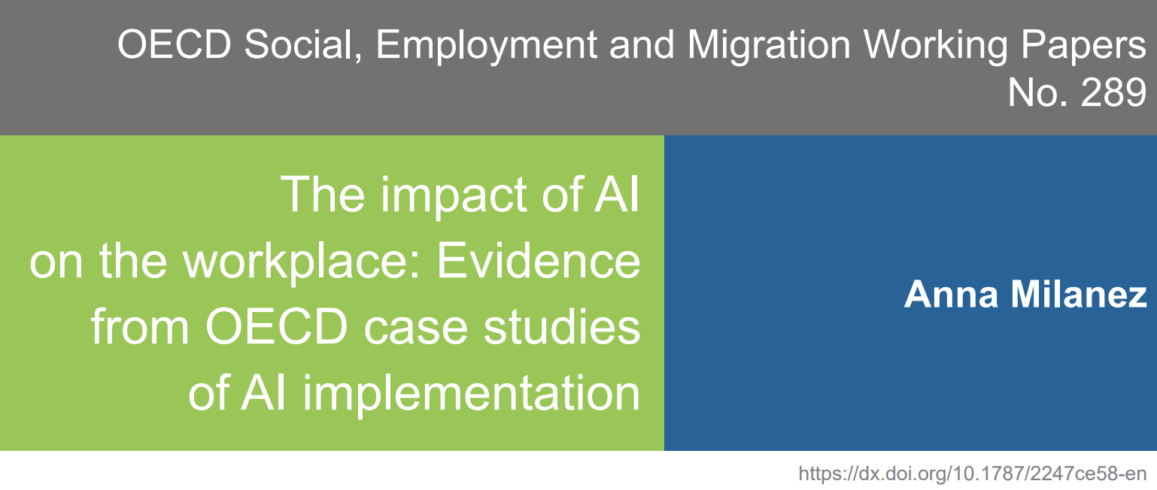
Case Study: Impact of AI on employment
2. AI and youth economic empowerment
This study is based on nearly 100 case studies of the impacts of AI technologies on workplaces in the manufacturing and finance sectors of eight OECD countries
The Impact of AI on the Workplace: Evidence from OECD Case Studies of AI Implementation
Key Insights
To date, job reorganization appears more prevalent than job displacement, with automation prompting the reorientation of jobs towards tasks in which humans have a comparative advantage
Job quality improvements associated with AI – reductions in tedium, greater worker engagement, and improved physical safety – may be its strongest endorsement from a worker perspective
The study also highlights challenges – skill requirements and reports of increased work intensity – underscoring the need for policies to ensure that AI technologies benefit everyone

Slide 16
TABLE OF CONTENTS
GLOBAL DATA & TECHNOLOGY STRATEGY – ARTIFICIAL INTELLIGENCE
1. AI KEY CONCEPTS Technology over time, AI definition, components, AI in our lives, navigating AI concerns
2. AI AND YOUTH ECONOMIC EMPOWERMENT Impact of AI on demand-sector needs, mitigating concerns, potential use cases, case study
3. GOYN USE OF AI Community implementations and results from the AI survey
4. CONCLUSION Considerations and next steps
5. ANNEX Resources for further learning and exploration

Slide 17
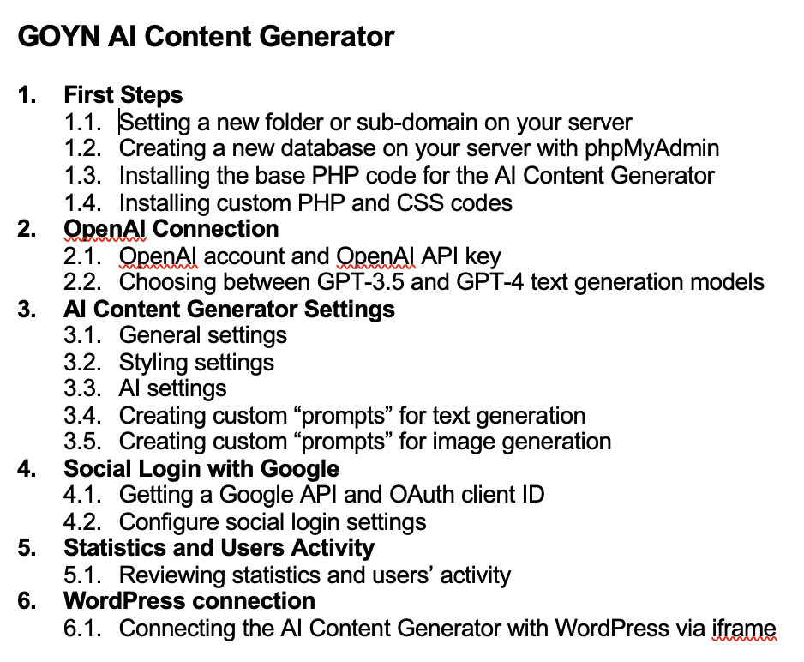
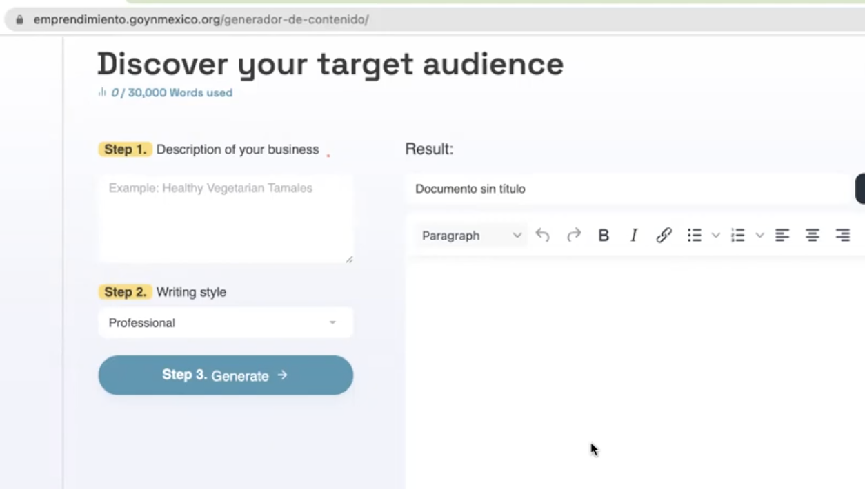
We are all at different stages of our AI journeys
3. GOYN use of AI
GOYN Mexico City have integrated AI in their Entrepreneurship Platform – Access recording in the learning lab
“Youth x Entrepreneurship” platform is made up of 4 sub-independent platforms
General Website: It is built in WordPress, includes most of the information and most of the sections such as Resources, the Advisory system, the Website Builder, the Image Editor, the VCard Card Generator, among other sections.
Entrepreneurs Forum: Also built in WordPress but in one installation independent of the general page, with its own database and its own users.
AI content generator: It is a system installed on the server, independent of WordPress and built in PHP with its own database and its users, this system works as a link between OpenAI and the General Website. The monthly cost of the OpenAI service depends on the consumption of the users and is not included in the previously mentioned costs.
Virtual Assistant Valeria: Smartphone for WhatsApp AI Virtual Assistant is a program connected to WhatsApp working from a cell phone with permanent internet connection. The cell phone requires its own number telephone and exclusive use so as not to affect the performance of the virtual assistant.
Mexico City are willing to help support other communities implement this solution:
Online documentation
6 months of support for communities that choose to implement
https://emprendimiento.goynmexico.org

Slide 18
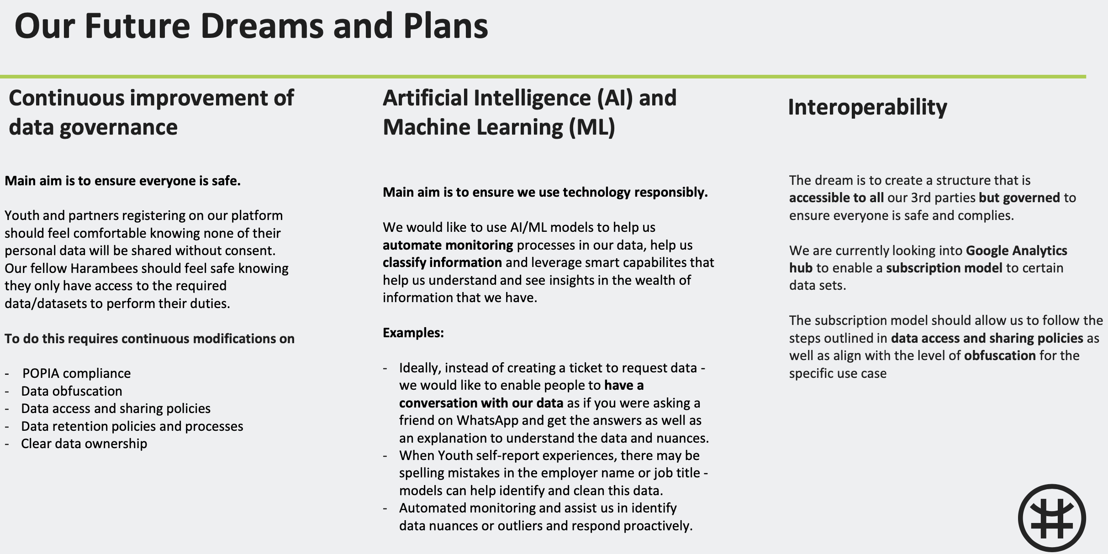
GOYN eThekwini are finalizing their AI Strategy: prioritizing responsible implementation
3. GOYN use of AI
Harambee have a governance-focused strategy (not yet shared), they will be presenting their data journey and roadmap on the 6th of March 2024

Slide 19
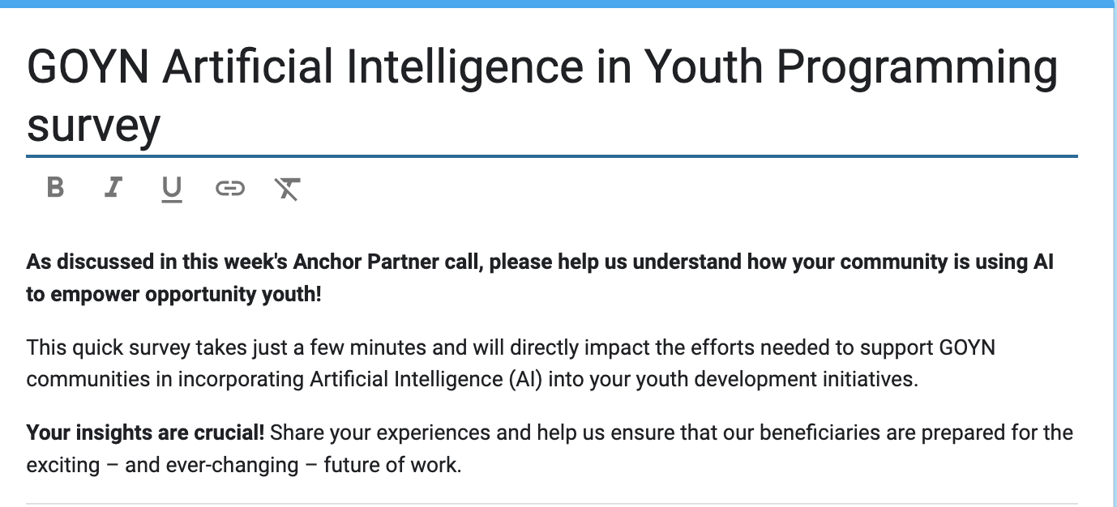
A survey on GOYN Aps efforts on the use of Artificial Intelligence (AI) for youth agency and economic empowerment
3. GOYN use of AI
On March 6th, 2024, the Global GOYN team discussed the transformative potential of Artificial Intelligence (AI) for youth agency and economic empowerment
To understand how our network is currently leveraging AI to support opportunity youth, we conducted a survey (15th March 2024) of all Anchor Partners
This presentation will outline the key survey results, providing insights to guide the development of GOYN's AI approach and ensure we maximize this technology's benefits for the young people we serve
9 APs responded to the Survey, representing 12 Communities (and 14 upcoming ones in India)
  Barranquilla, Bogota, Mexico City, Mombasa, Pune, Raichur, Ramgarh, Sáo Paulo, Tanga
GOYN eThekwini presented their AI approach in the March 6th Data & Tech CoP
Some GOYN communities requested support in understanding AI

Slide 20


GOYN Network’s is actively implementing and researching on the impact of AI in youth programming
3. GOYN use of AI
Almost all GOYN Anchor Partners are proactive in integrating AI to support OY in their communities
Communities presented diverse perspectives, reflecting various levels of experience with AI
There was active engagement from the communities, demonstrating a forward-thinking approach, seeking both knowledge and practical assistance
The survey validates a potential for consolidation on thought leadership, tooling and usage of AI within the network for collective impact
Many communities are researching on the impact of AI on the future of work; potential to consolidate this across the network for the benefit of all?
Over 50% of respondents identified benefits in getting support on:
  Identifying appropriate AI tools for our beneficiaries (support Opportunity Youth)
  Developing and implementing AI use-cases in communities
  Develop an AI Strategy
  Training of staff on use and adoption of AI tools and it’s impact in youth programming
Affordability and cost: A request for support was made regarding compute resources and subscriptions

Slide 21
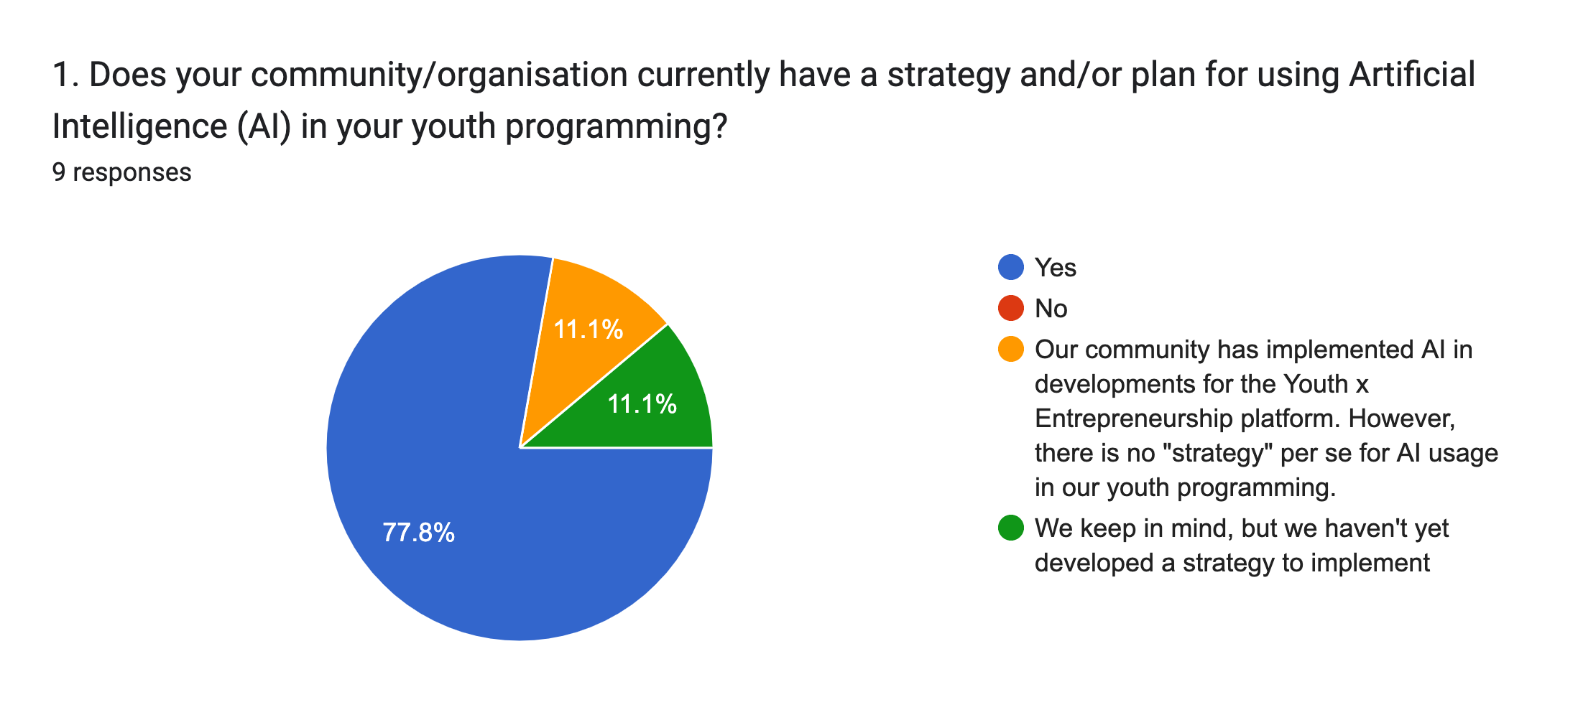
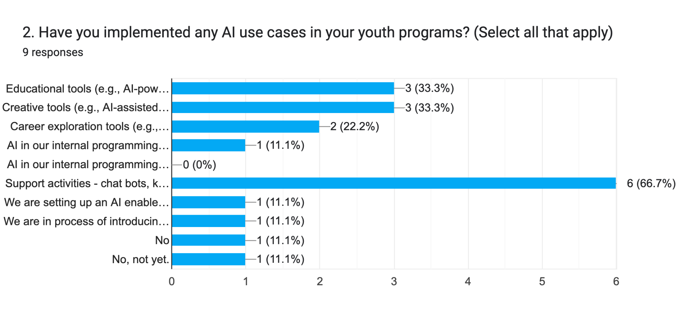
AI adoption is high among GOYN communities with varying levels of implementation
3. GOYN use of AI
Use of AI in support activities e.g. chatbot and/or knowledge base is the most widely used use case in our network, inline with current trends in generative AI
No community reported to have implemented AI to support AI in their internal programming e.g. research and impact (but we might not have considered Machine learning as AI)
Some GOYN communities reached out and asked for support to understand use of AI
N=9
Notes:
Community
AI use-cases currently implemented by community
Barranquilla
No
Bogota
Support activities - chat bots, knowledge base
Mexico City
Support activities - chat bots, knowledge base
Mexico City
Creative tools (e.g., AI-assisted content creation, translation or any creative works creation)
Mexico City
Educational tools (e.g., AI-powered tutoring systems, personalised learning)
Mombasa
Educational tools (e.g., AI-powered tutoring systems, personalised learning)
Mombasa
Career exploration tools (e.g., AI-powered career matching)
Mombasa
Creative tools (e.g., AI-assisted content creation, translation or any creative works creation)
Pune
Support activities - chat bots, knowledge base
Pune
We are in process of introducing chat bot, knowledge base for upcoming activities for youth empowerment
Raichur
Educational tools (e.g., AI-powered tutoring systems, personalised learning)
Raichur
Support activities - chat bots, knowledge base
Raichur
Career exploration tools (e.g., AI-powered career matching)
Raichur
We are setting up an AI enabled training centre in the Raichur youth hub
Ramgarh
No
São Paulo
Support activities - chat bots, knowledge base
Tanga
Creative tools (e.g., AI-assisted content creation, translation or any creative works creation)
Tanga
AI in our internal programming - Machine learning for data analytics
Tanga
Support activities - chat bots, knowledge base

Slide 22
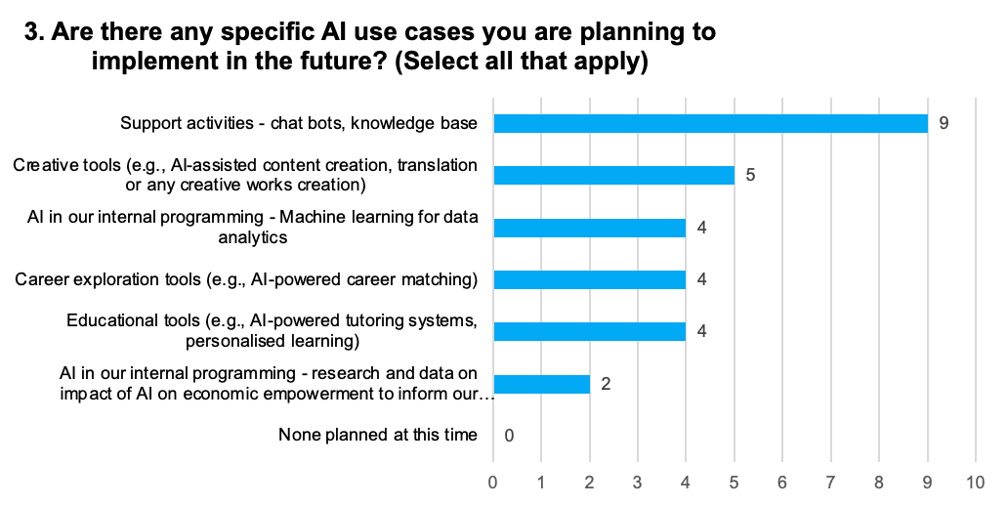
All GOYN Communities are embracing AI with support functions leading the way
3. GOYN use of AI
Community | # planned
Barranquilla | 3
Bogota | 1
Mexico City | 3
Mombasa | 6
Pune | 2
Raichur | 5
Ramgarh | 1
São Paulo | 1
Tanga | 6
N=9
GOYN eThekwini presented at the March D&T CoP and are prioritizing use of AI for internal programing >> “automate monitoring processes in our data, help us classify information and leverage smart capabilities that help us understand and see insights in the wealth of information that we have”
Some communities reached out and asked for support to understand use of AI

Slide 23
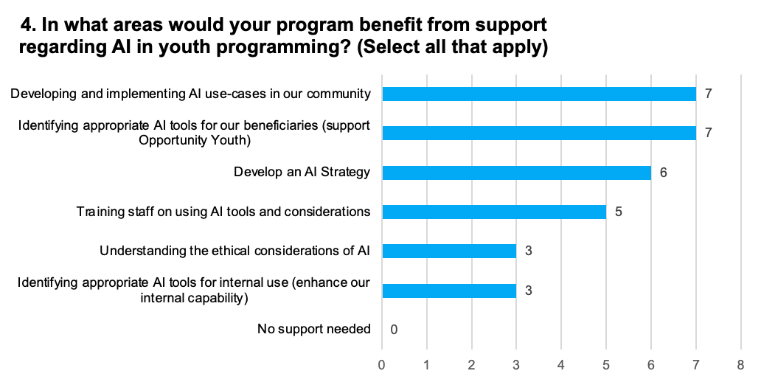
The top AI support needs are equally split: Communities seek help with both identifying AI tools and developing use cases for youth programming
3. GOYN use of AI
With communities demonstrating common needs, GOYN Network can form a collaborative AI think tank to identify and implement use cases easily localized by communities
This collective approach could unlock accessible AI tools and compute power, ultimately benefiting millions of young people
N=9
Despite 7 communities indicating that they had AI strategies, 6 communities responded to needing support to develop one. The initial indication of having an AI strategy might reflect a high-level goal. However, when asked specifically about support, communities might be seeking help with the detailed development and/or implementation of that strategy (to be explored further)
All communities identified an area of support

Slide 24
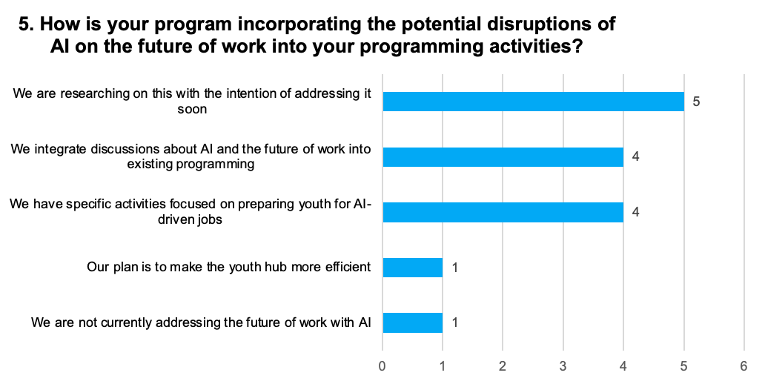
To address impact of AI on the future of work, most communities are actively preparing OY using a mix of research, targeted activities and integrated discussions
3. GOYN use of AI
Awareness and Preparation: Majority of GOYN communities acknowledge the importance of addressing AI's impact on the future of work. However, the level of preparedness varies
Three Main Approaches to addressing impact on future of work:
  Integration: Many communities are incorporating AI discussions into existing programs
  Research: Several communities are actively researching AI's impact with plans to develop future programming
  Specific Focus: A few communities already have dedicated activities aimed at preparing youth for AI-driven job markets
Opportunity Gap: Only one community reported not currently addressing AI's impact on the future of work. There is an opportunity to tailor support to them based on the collective network's efforts and learnings
N=9

Slide 25

Direct questions and comments from the survey
3. GOYN use of AI
Affordability:
  “What is the limit and cost of useful AI to our community?”
  “We'd like to experiment and build more AI products, but it's expensive in terms of compute power and subscriptions. Are you guys in a position to assist with this?“
Understanding the impact of AI to OY:
  “How much are young people affected by the changes that Artificial Intelligence produces in current professions?”
  We need to understand potential roadblocks that we might encounter in future
Communities are actively implementing initiatives
  “We are initiating the AI-enabled employability and entrepreneurship skill training in the youth hub”
  “We are preparing research on the impacts of AI on jobs in the digital sector to adapt strategies”
  “AI was first explored with Youth x Entrepreneurship. We are undergoing the first evaluation and will share if any results are relevant regarding AI usage in youth programming”
  Acknowledges the relevance of having and AI strategy and are already planning the best roadmap to achieve this goal.

Slide 26
TABLE OF CONTENTS
GLOBAL DATA & TECHNOLOGY STRATEGY – ARTIFICIAL INTELLIGENCE
1. AI KEY CONCEPTS Technology over time, AI definition, components, AI in our lives, navigating AI concerns
2. AI AND YOUTH ECONOMIC EMPOWERMENT Impact of AI on demand-sector needs, mitigating concerns, potential use cases, case study
3. GOYN USE OF AI Community implementations and results from the AI survey
4. CONCLUSION Considerations and next steps
5. ANNEX Resources for further learning and exploration

Slide 27





Which part of our data value chain can benefit from AI adoption?
4. Conclusion
Design
Sourcing
data by type
Manage
the data (database)
Analyze
and validate
Tell the story
Action
Define the opportunity and/or problem to solve and decisions to be made
Identify how the data will be used and by whom
Identify the indicators to track (baseline and changes)
Identify the data that will be sourced and how often updated
Design the data collection tools and methodologies and determine if primary or secondary data
Government: Kenya National Bureau of Statistics, County government, Ministry of Labour
Secondary research: Ecosystem mapping, public databases
Private Sector: Phone data, purchasing data
Primary Surveys: Offline observations and interviews with a variety of stakeholders (research companies or “citizen driven data”)
Geospatial: satellite information but also primary asset mapping
Aerial: Drone mapping
Organize the data
Develop structured databases (MySQL, Oracle, etc)
Leverage on emerging technologies such as distributed ledgers for data sharing with collaborative members
Input information with shift from manual to automated integration/APIs with existing structure data
Align on regular update cycles
Adopt critical data privacy considerations
Implement rigorous data integrity and usage rules
Logic and analytical methods are applied to interpret the data
Data analysis that includes running basic queries, reporting on ratios and insights, tracking of indicators over time
Advanced data techniques include simulations and scenario planning, big data mining, to algorithms leveraging ML/AI for efficient planning and resource allocation
“History is written by the winners”
Decisions are made
Impact is evidence-based
Systems change can be attributed to programmatic effort
Action is taken based on relevant data in collaboration with Opportunity Youth
Informed implementation with effective feedback loops
Use of the data and insights
Insights inform decisions & actions – able to show gaps, recommendations on allocations of resources, investment areas and progress over time
Sharing of information within collaboratives and beyond: key stakeholders via meetings, reports and publications or through policy forums
Effective communication strategies to inform and engage the general public, utilizing social and traditional media, thought leadership content, and impactful case studies

Slide 28
Potential next steps:
4. Conclusion
Proposed next steps:
Case Studies and Best Practices:
  Document successes of communities actively implementing AI (Raichur, Bogota, Mexico City), challenges, lessons learned, and models for replication in other communities
Strategic AI Roadmap Workshop >> **GOYN Convening**
  Develop a workshop specifically designed to help communities create actionable AI strategies tailored to their youth programs. Include sections on goal setting, resource assessment, skills gap analysis, and implementation planning
AI Strategy Consulting support >> Think Tank??
  Consider partnering with university(ies) or tech companies that might have resources to offer pro-bono or subsidized support and offer one-on-one, tailored consulting support for communities seeking to develop or refine their AI strategies
  Ethical AI Emphasis: Incorporate ethical considerations about AI and potential biases into all activities
Strategies to reduce AI implementation costs:
  Create a toolkit outlining strategies to reduce AI implementation costs which include compute power, software, training data and skills (seeking open-source tools, sharing resources between communities, etc.)
Addressing the Skills Gap:
  Curate and design resources that help bridge the AI skills gap, preparing staff to implement and manage AI initiatives
Insights:
Understanding AI's Impact is Critical: Communities demonstrate an urgent desire to understand AI's potential disruption of the job market and how it will affect the youth they serve
Active Implementation: Several communities are already taking commendable steps to address AI (Raichur, Bogota, Mexico City). Learning from each other’s experiences is crucial
A Strategy Gap: Communities want to implement AI, but often lack specific strategies or detailed roadmaps for execution.
Affordability Remains a Key Barrier: The recurring theme highlights that even with an interest in AI adoption, the cost is a major roadblock

Slide 29
Discussion?
What can we do together to harness the power of AI?

Slide 30
TABLE OF CONTENTS
GLOBAL DATA & TECHNOLOGY STRATEGY – ARTIFICIAL INTELLIGENCE
1. AI KEY CONCEPTS Technology over time, AI definition, components, AI in our lives, navigating AI concerns
2. AI AND YOUTH ECONOMIC EMPOWERMENT Impact of AI on demand-sector needs, mitigating concerns, potential use cases, case study
3. GOYN USE OF AI Community implementations and results from the AI survey
4. CONCLUSION Considerations and next steps
5. ANNEX Resources for further learning and exploration

Slide 31
Resources for further learning and exploration
5. ANNEX
AI Tools - a diverse array of tools spanning education, writing, and various AI applications
# | AI Tool | Link | Description
1. | ChatGPT | OpenAI - ChatGPT | Generative AI tool by OpenAI
2. | Gemini | Gemini | Generative AI tool by Google
3. | CopyAI | CopyAI | An AI writing tool assisting in refining writing nuances
4. | Grammarly | Grammarly | An AI-powered tool for grammar and editing improvement
5. | Quillbot | Quillbot | An AI tool for paraphrasing text
6. | ChatPDF | ChatPDF | An AI tool assisting with research tasks
7. | Upword | Upword | An AI tool for summarizing text
8. | Natural Readers | Natural Readers | An AI tool that converts text to speech
9. | Mubert | Mubert | An AI tool that converts text to music
10. | Doctrina | Doctrina | An AI learning tool providing access to notes and quizzes
11. | Coursera | Coursera | An online learning platform using AI for personalized course recommendations
12. | Udacity | Udacity | An AI-driven educational platform offering nanodegree programs and skill-based courses
13. | EdX | EdX | An AI-enhanced learning platform offering a wide range of courses from universities and institutions globally
14. | A Cloud Guru | A Cloud Guru | An AI-driven platform for cloud computing education, including courses on AWS, Azure, and Google Cloud
15. | Skillshare | Skillshare | An AI-powered online learning community for creative skills, including design, photography, and entrepreneurship
16. | Repl.it | Repl.it | An AI-assisted coding platform for learners and developers to collaborate on coding projects in various languages
17. | DataRobot | DataRobot | An AI platform for automated machine learning, assisting in building, deploying, and managing machine learning models
18. | H2O.ai | H2O.ai | An open-source platform for AI and machine learning that provides tools for data analysis, modelling, and deployment
19. | RapidMiner | RapidMiner | An AI-driven data science platform that facilitates data preparation, machine learning, and predictive model deployment
20. | Alteryx | Alteryx | An AI-powered data blending and analytics platform for preparing, blending, and analysing data for better insights
21. | IBM Watson Studio | IBM Watson Studio | A cloud-based AI and data science platform for building, training, and deploying machine learning models
22. | Kaggle | Kaggle | An online platform for data science competitions, datasets, and collaboration, offering a community-driven learning environment
23. | RapidAPI | RapidAPI | An AI-powered platform connecting developers with thousands of APIs, facilitating the development of innovative applications

Slide 32
Resources for further learning and exploration
5. ANNEX
AI Tools (contd…)
# | AI Tool | Link | Description
24. | AWS Comprehend | AWS Comprehend | A natural language processing service by AWS for extracting insights and relationships from text
25. | IBM Watson Natural Language Understanding | IBM Watson NLU | A cloud-based service for analysing text to extract metadata, entities, sentiment, and more
26. | Azure Machine Learning | Azure ML | A cloud-based service by Microsoft offering tools for building, deploying, and managing machine learning models
27. | Google Cloud AI | Google Cloud AI | A suite of AI tools and services on the Google Cloud Platform, including machine learning, natural language processing, and more
28. | TensorFlow | TensorFlow | An open-source machine learning framework developed by Google, used for building and training deep learning models
29. | PyTorch | PyTorch | An open-source machine learning library developed by Facebook, known for its dynamic computational graph and ease of use
30. | Wit.ai | Wit.ai | An open-source natural language processing platform by Facebook for building applications with conversational interfaces
31. | Jupyter Notebooks | Jupyter Notebooks | An open-source web application for creating and sharing live code, equations, visualizations, and narrative text in a collaborative environment
32. | DataRobot AutoML | DataRobot AutoML | An automated machine learning platform that streamlines the process of building and deploying machine learning models
33. | Snorkel | Snorkel | An open-source platform for programmatically creating and managing training datasets for machine learning models
34. | BigML | BigML | An AI platform that simplifies machine learning through automated modelling, enabling users to create and deploy models with ease
35. | Chatbot.com | Chatbot.com | An AI-powered chatbot platform allowing users to create and deploy chatbots for various applications, including customer support

Slide 33
Resources for further learning and exploration
5. ANNEX
AI Blogs – rich content, exploring ethical considerations, job impacts, and advancements in AI
# | Blog Name | Link | Description
1. | Neuron | The Neuron | AI trernds and tools you need to know to stay ahead of the curve
2. | OpenAI Blog | OpenAI Blog | Insights, research, and updates from OpenAI, covering a wide range of AI-related topics
3. | Towards Data Science | Towards Data Science | A blog on Medium featuring articles and tutorials on data science, machine learning, and AI
4. | AI Weekly | AI Weekly | A curated newsletter providing updates, news, and articles on AI and machine learning
5. | Synced | Synced | A platform offering AI news, research summaries, and insights into the latest developments in the field
6. | The AI Report | The AI Report | A blog covering AI news, trends, and analysis, with a focus on its impact on society and businesses
7. | AI Trends | AI Trends | A blog providing insights into the latest trends, applications, and advancements in the field of AI
8. | Google AI Blog | Google AI Blog | Official blog by Google AI, featuring research updates, insights, and announcements from Google's AI teams
9. | Microsoft AI Blog | Microsoft AI Blog | Official blog by Microsoft AI, covering AI research, applications, and innovations powered by Microsoft
10. | Distill.pub | Distill.pub | A journal and blog aiming to facilitate the clear communication of complex topics in machine learning research
11. | MIT Technology Review - AI | MIT Technology Review - AI | AI-related articles and analysis from MIT Technology Review, covering the latest advancements and ethical considerations

Slide 34
Resources for further learning and exploration
5. ANNEX
AI Courses
# | Course Name | Link | Description
1. | Coursera - AI for Everyone | AI for Everyone | A non-technical course by Andrew Ng, providing an introduction to AI concepts and their impact on society
2. | edX - Artificial Intelligence | edX - Artificial Intelligence | A foundational course by Microsoft on edX, covering AI principles, applications, and ethical considerations
3. | The Artificial Intelligence (AI) for K-12 initiative | https://ai4k12.org/resources/list-of-resources/ | Curated list of books, curriculum materials, course outlines, software, videos, and more. The list includes professional development courses for educators to learn about AI
4. | Udacity - Intro to Artificial Intelligence | Udacity - Intro to AI | A beginner-friendly course introducing fundamental concepts of AI, machine learning, and problem-solving
5. | Stanford Online - Machine Learning | Stanford Machine Learning | A comprehensive online course by Stanford University, covering machine learning techniques and applications
6. | MIT OpenCourseWare - Introduction to Deep Learning | MIT OCW - Deep Learning | A course exploring deep learning fundamentals and applications from MIT OpenCourseWare
7. | Fast.ai - Practical Deep Learning for Coders | Fast.ai - Practical DL | A hands-on course offering practical insights and applications of deep learning for coding enthusiasts
8. | IBM Data Science - Machine Learning with Python | IBM Data Science | A course on Coursera by IBM, focusing on machine learning using Python and real-world applications
9. | Kaggle Courses - Introduction to Machine Learning | Kaggle - Intro to ML | An interactive course on Kaggle, introducing machine learning concepts through hands-on exercises and projects
10. | DeepLearning.AI - Natural Language Processing Specialization | NLP Specialization | A specialization by DeepLearning.AI on Coursera, delving into natural language processing and its applications
11. | Harvard Extension School - Data Science Certificate | Harvard Extension School | A certificate program covering various data science topics, including AI, from Harvard Extension School

Slide 35
Resources for further learning and exploration
5. ANNEX
Others
Further links and publications on various industry efforts to collaborate on AI advancements:
https://docs.google.com/document/d/1tqgm992tnMHW65gk6Pha0OT2ysrMPmXXUr0GzKjCB2U/edit?usp=sharing
GOYN Mombasa recommended link to upskill OY on advanced digital skills training
https://www.datacamp.com/donates

